Slide 1

Self-adjusting Weighted Networks
Student: S. Pankratov
Supervisor: V. Aksenov
Consultant: S. Schmid

Slide 2
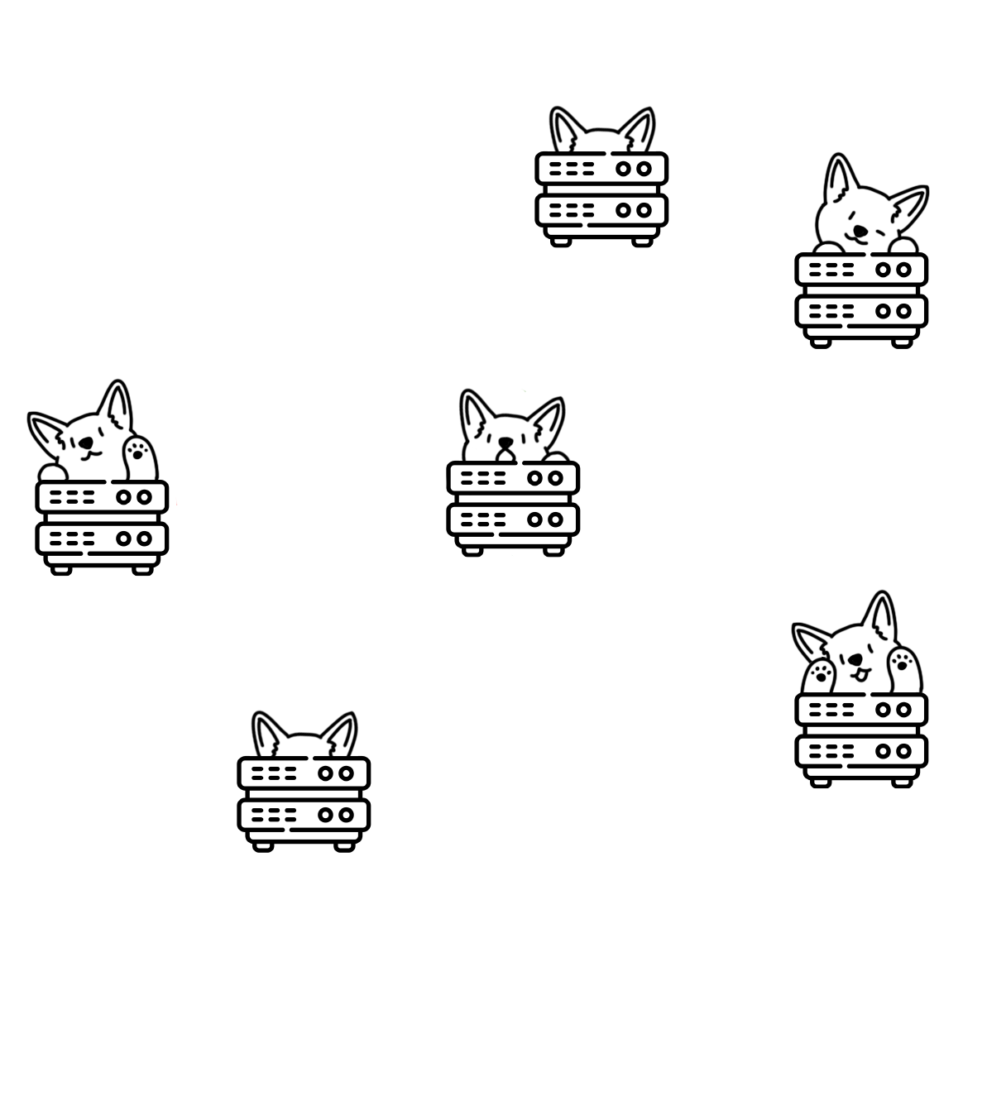


Networks
m nodes representing servers / server racks / computers / etc.
nodes are connected via physical connections
Can be represented as a graph

Slide 3

Request sequence
N virtual nodes
Nodes communicate with each other
Sending routing request from node i to node j
{
1
3
,
2
1
,
1
5
,
1
3
,
1
3
,
7
4
,
i
j
…
}
2
3
,

Slide 4
Virtual networks
N virtual nodes
Nodes communicate with each other
Can be represented as a graph
1
4
6
4
3
3
1
8
2
5
7
3
12
4
2
8
4
9
1
3

Slide 5
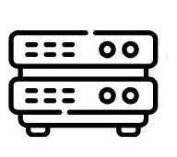

Problem
Find most optimal way to embed virtual cluster on physical topology
1
2
…
N
?
Network
Virtual network

Slide 6
Applications
Optimizing routing in distributed datacenters
Numerical analysis
Graphics
Parallel processing
…

Slide 7

Bounded degree network by Chen Avin, [et.al]
Construct an optimal network, from the given demand
Degree on each node is bounded
For some virtual network near-optimal solutions can be constructed (trees, low average degree, sparse graphs, …)
1
5
2
4
3
Some optimal solution

Slide 8
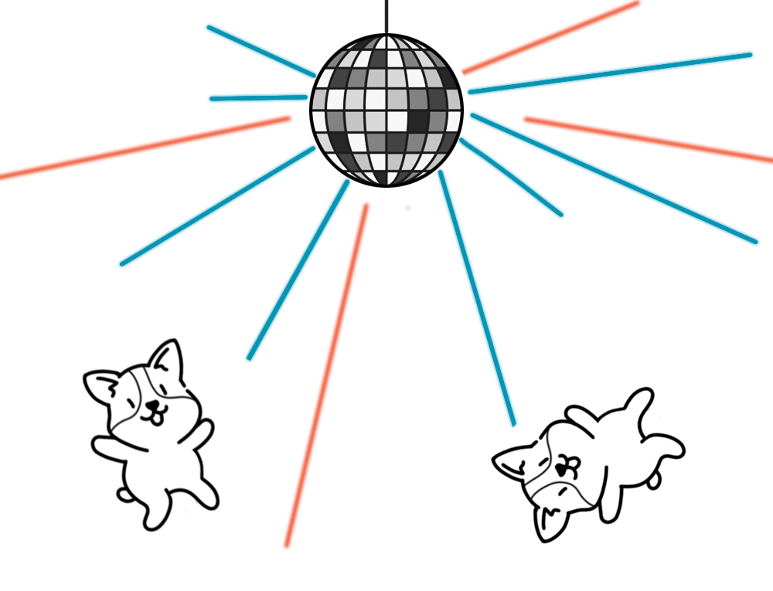
Self-Adjusting Networks
m nodes representing servers / server racks / computers / etc.
nodes are connected via physical connections
Can be represented as a graph
Can change the topology online

Slide 9
SplayNet by Stefan Schmid , Chen Avin, [et.al]
root
Online Self-adjusting Network - routing request (i, j) - self-adjusting - is a tree
On request (i, j), move nodes i and j to LCA(i, j)
Optimal in some specific cases
7
15
17
4
10
5
20
1
12
2
9
Request (5, 7)

Slide 10
Networks
c=3
3, c=2
1, c=1
2, c=2
1, c=1
1, c=3
c=1
6, c=8
4, c=1
c=1
c=2
Simple model
?
Network with varying capacities / weights

Slide 11

Star Application by Matthias Rost, [et.al]
switch
switch
center
5, c=2
1
C
β
β
6
5
C
1, c=1
1, c=1
β
β
1, c=1
β
C
4
2
C
3
server
server
server
C
C
Network with capacities and weights on edges
Virtual Cluster with bandwidths

Slide 12

Future work
Tree virtual network
Linear / cyclic networks
With weights and capacities
Online problem
Requests are not known upfront
We can move virtual nodes from one physical node to another
Approximation algorithms
1
2
server
server
1
2
server
server

Slide 13
Thank you for
your attention!
Illustrations by
@svartvein

